Slide 1
Peer-graded Assignment: Capstone Project - The Battle of Neighborhoods
Moving to Houston, Texas, USA
Amir Kassenev

Slide 2
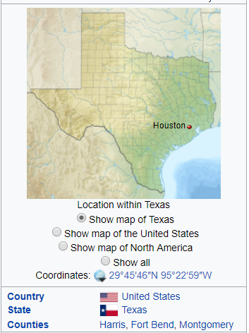
Introduction: Business Problem
In this project, I will be using my persona real live case.
I am planning to move to Houston, Texas, U.S. in next few months and looking for an area to buy a house or apartment. This case will be useful for anyone planning to move to a new area/city and looking for an area to buy a house.
Since Houston is is the most populous city in the U.S. state of Texas and the fourth most populous city in the United States with the area of 627 sq mi, it is a quite challenging task to find the right place to settle.
We will be looking for an area/neighborhood with the following requirements:
1. Neighborhood with the best schools *
2. Neighborhood with low crime rate
3. As close to the city center as possible
We will use our data science powers to generate a few most promising neighborhoods based on these criteria. Advantages of each area will then be clearly expressed so that the best possible final location can be chosen by Family.

Slide 3

Data
Based on definition of our task, factors that will influence our decision are:
number of Schools in the neighborhood (any type of schools) distance
neighborhood crime rate
distance of neighborhood from city center
We decided to use regularly spaced grid of locations, centered around city center, to define our neighborhoods.
Following data sources will be needed to extract/generate the required information:
Wikipedia - list of Houston neighborhoods (https://en.wikipedia.org/wiki/List_of_Houston_neighborhoods)
Crime Statistics in Houston ranking - https://www.neighborhoodscout.com/tx/houston/crime
Best Schools in Houston ranking - https://www.neighborhoodscout.com/tx/houston/schools

Slide 4

Methodology
The key library that was used in this project is Beautiful Soup – to scrap data from the web sites
Advanced table data manipulation was used to combine results from several requests (each to meet specific criteria) and results in final list of neighborhood
Foursquare was used to get Chinese restaurants close to the neighborhood
Folium was used to demonstrate results on the map

Slide 5
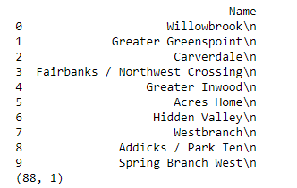
Results
List of neighborhood was taken first from Wikipedia
URL = "https://en.wikipedia.org/wiki/List_of_Houston_neighborhoods" #reading Houston Neighborhoods from Wikipedia

Slide 6
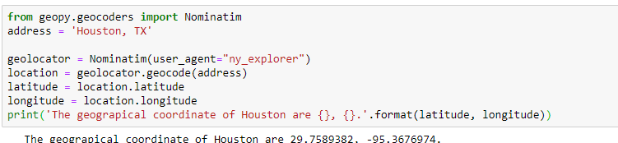
Results
Houston coordinates were taking using Geocoders

Slide 7
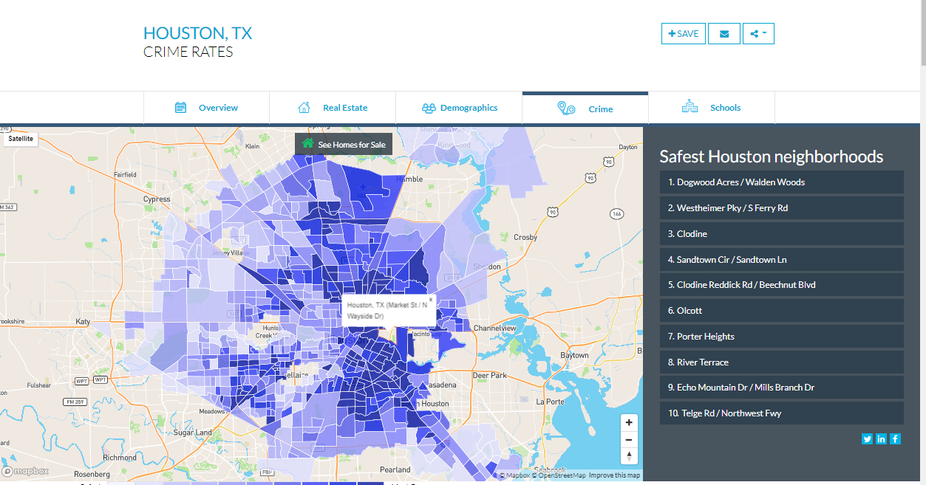
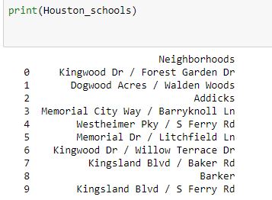
Results – safest neighborhood
From www.neighborhoodscout.com/tx/houston we scrapped best 10 neighborhood with lowest crime rate

Slide 8
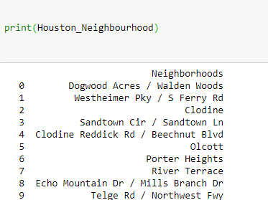
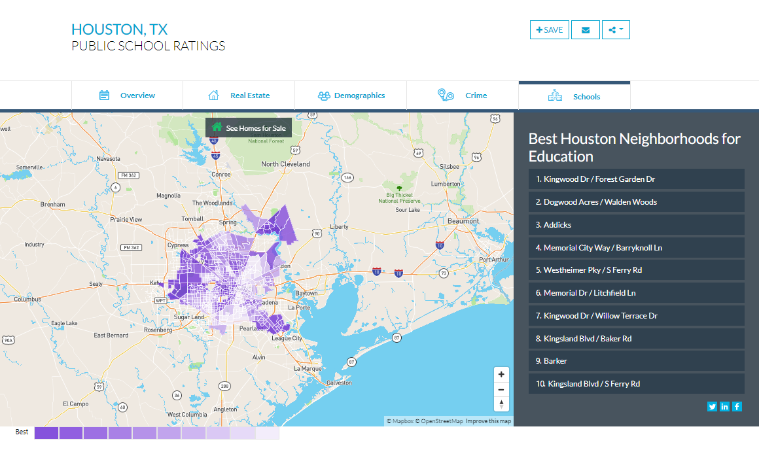
Results – best schools
From www.neighborhoodscout.com/tx/houston we scrapped best 10 neighborhood with highest school rating

Slide 9
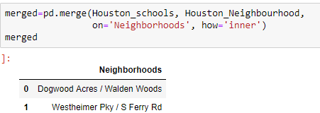
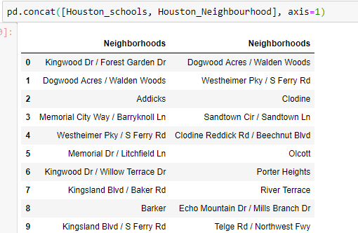
Results – merge two tables
Merged:
Neighborhood with Best schools and safest!
Safest neighborhood
Neighborhood with Best schools

Slide 10
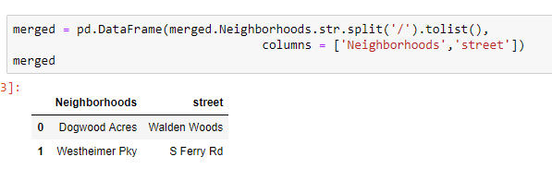
Results – split Neighborhood name and street
Split Neighborhood name and street into two columns as joint name will not work to find coordinates

Slide 11
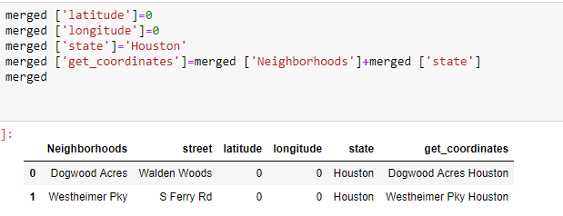
Results – prepare table
Add empty columns with coordinates (latitude and longitude)
Add state column (Houston)
Add new column (Neighborhood + State) that will be used in getting coordinates

Slide 12
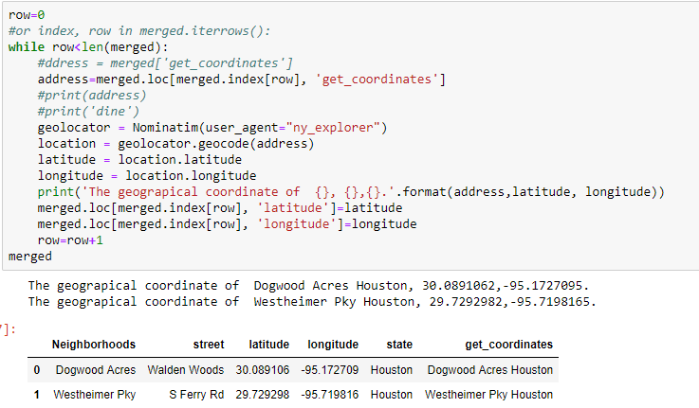
Results – Coordinates are obtained, lets move forward

Slide 13
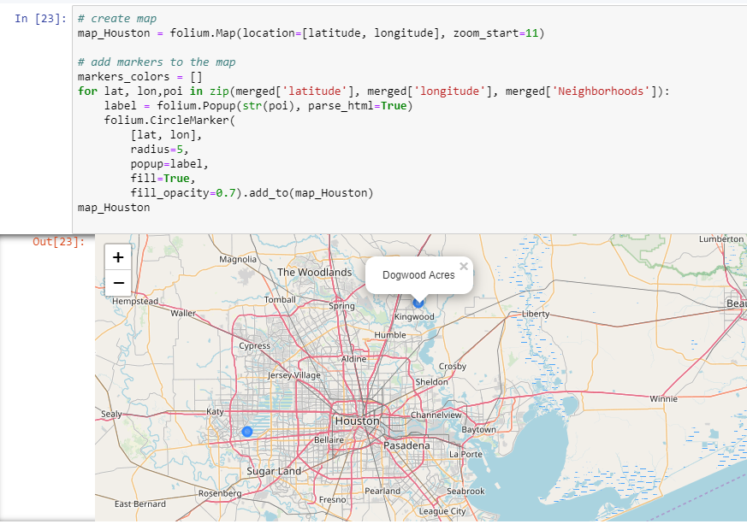
Results – map is here, lets move then!

Slide 14
Discussion
Both neighborhood that resulted from this exercise are quire far from the city center therefore additional KPI should be considered, as home pricing, community and etc. This will be taking into account when we will visit Houston next month.

Slide 15
Conclusion
In conclusion, this was very useful final project where Python skills helped me find best neighborhood as I am planning to move to Houston in reality.
Data scrapping from the website and Fore Square API is very powerful technique
Data visualization using mapping tools as folium is an amazing to demonstrate to my wife ☺

Slide 16
Final link
https://dataplatform.cloud.ibm.com/analytics/notebooks/v2/e854f446-12d1-4b0d-9cf2-8353d012aab5/view?access_token=ee42243ffd7a5e1716b8655633586124b48a97cd5ccf01cbebfdbef50a0252ba

